Slide 1
Simulating IMT Response and Performance
Daniel Jarvis, Thesis Defense

Slide 2
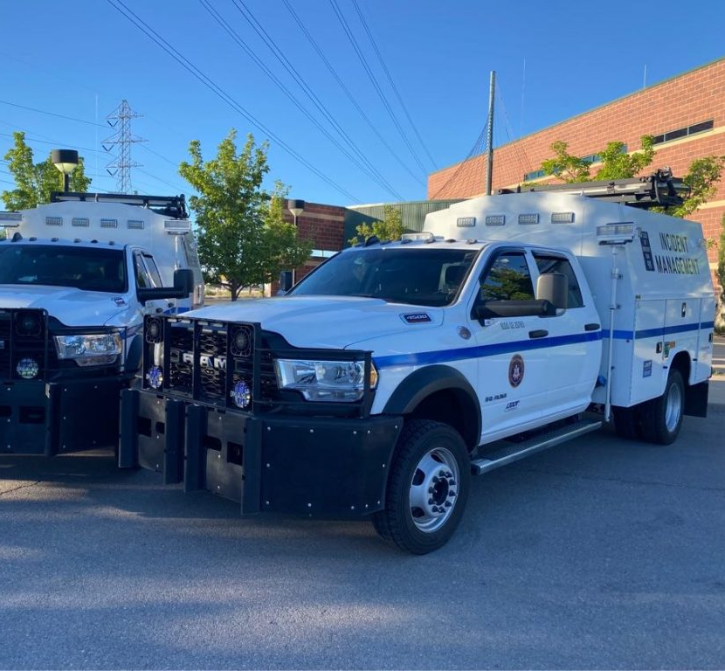
Outline
Literature Review
Methodology
Results
Conclusions

Slide 3
Literature Review

Slide 4
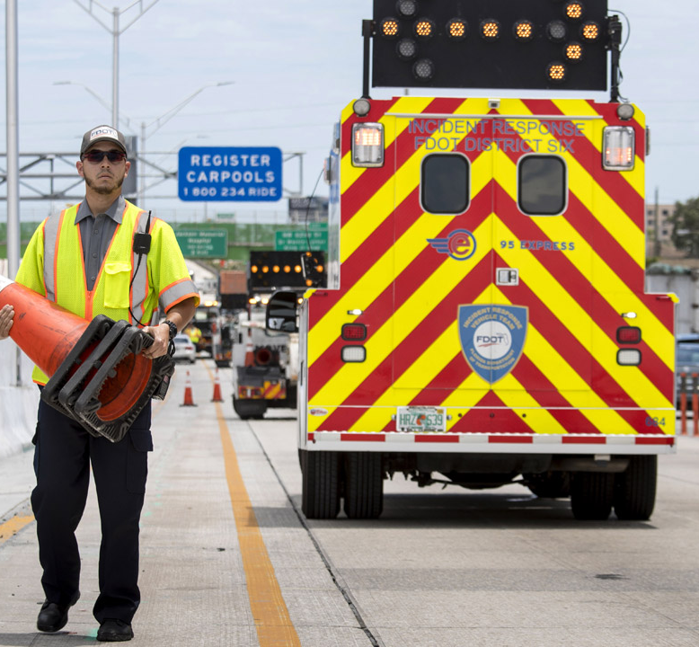
Lit. Review – IMT Operations
Skabardonis (1998)
Bennett et al. (2021)
Bennett et al. (2022)
Hadfield et al. (2021)
Schultz et al. (2023)
Hadfield et al. (2021) found that for every minute of delay in IMT response time:
Delay Impact: 0.8-minute increase in RCT
Vehicles Affected: 93 additional vehicles delayed
Total travel time: increased by 34.6 minutes
Cost: Additional expense of $925 for drivers
Notes:
Skabardonis (1998) demonstrated that the IMT in California significantly reduced incident response and clearance times, with a cost-benefit ratio of 5:1 and decreased on-scene time for patrol officers. Our focus is on operational studies in Utah; however, similar programs in states like California and Florida have also proven to be effective.

Slide 5
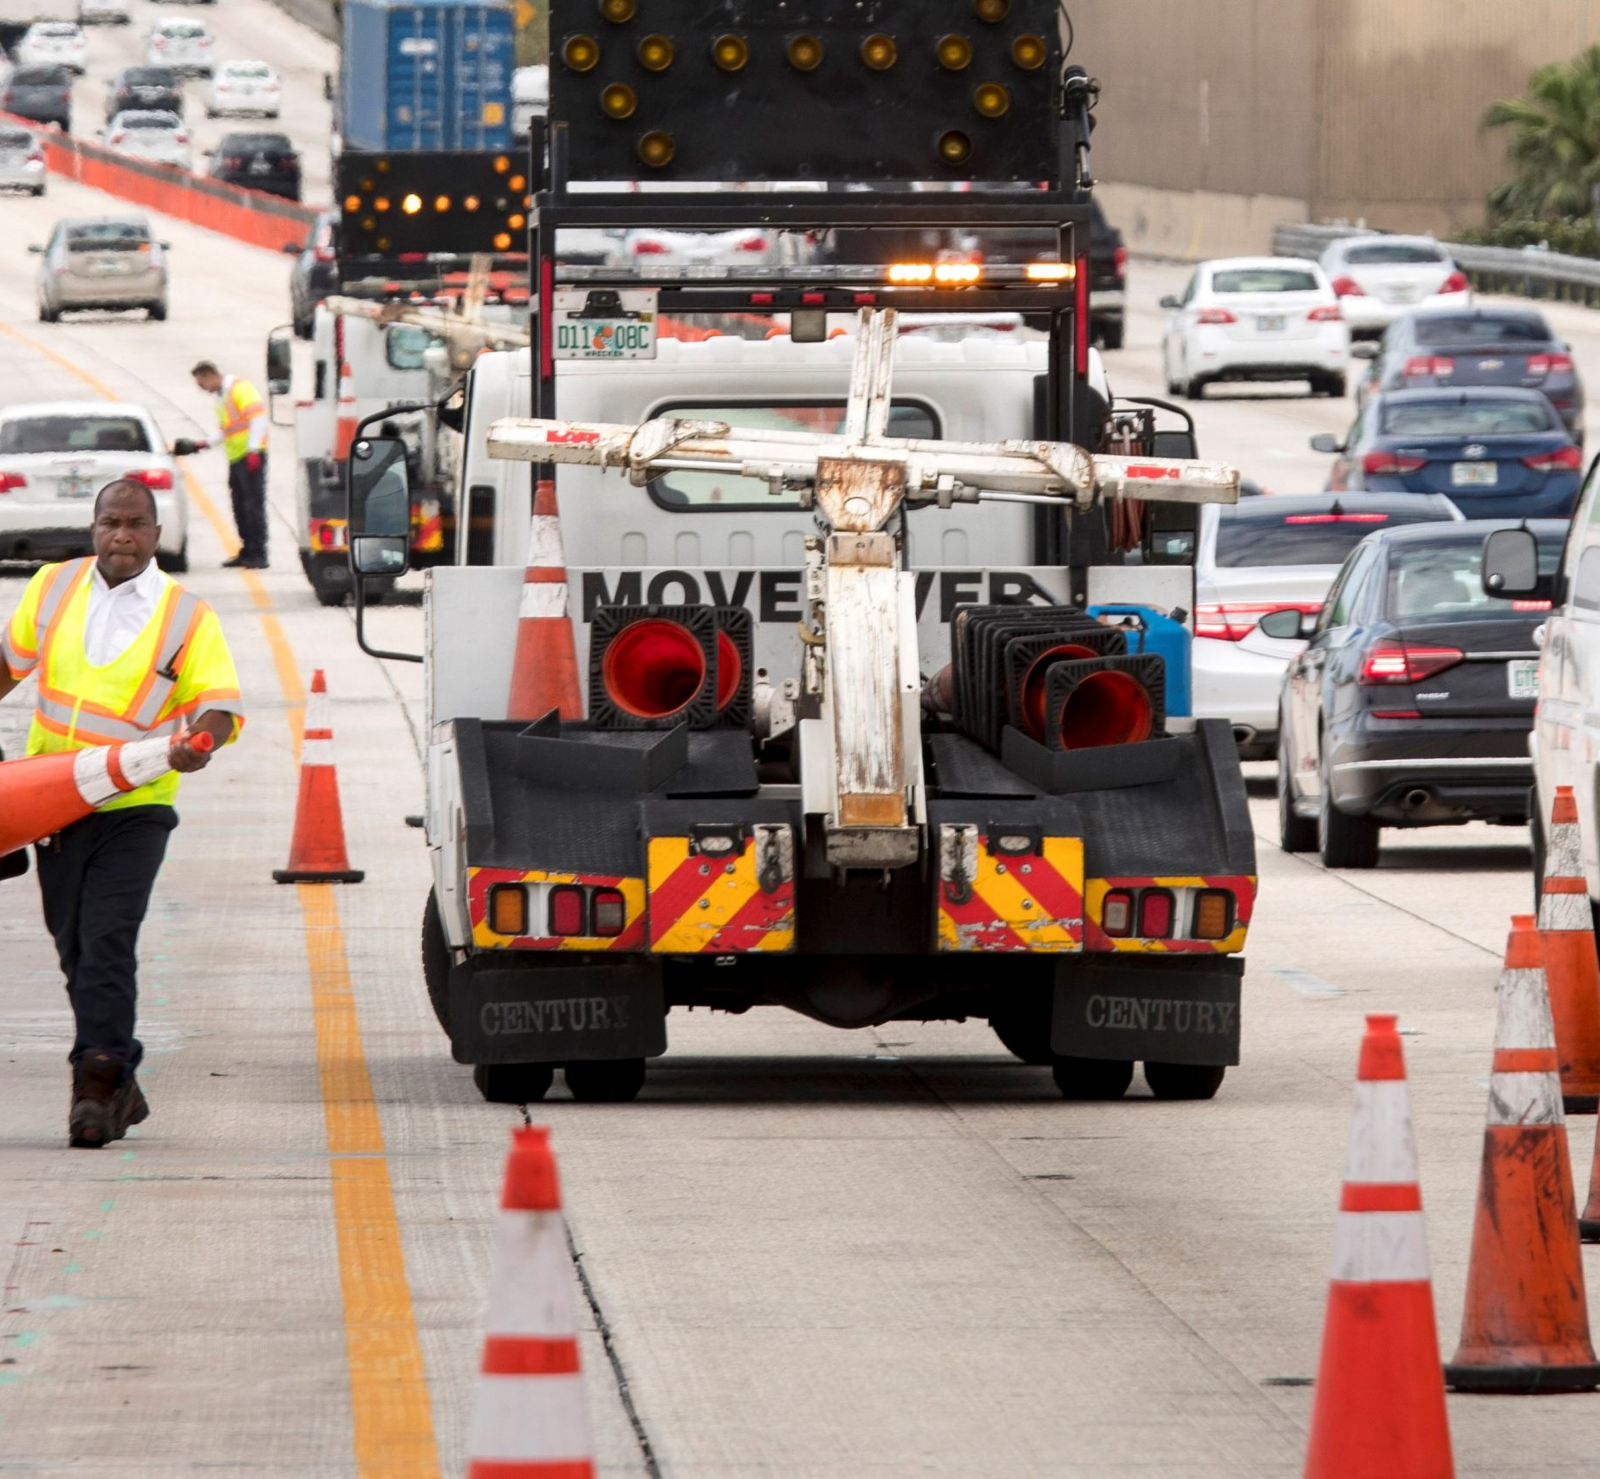
Lit. Review – IMT Optimization
Lou et al. (2011)
Optimization model for minimizing IMT response times on a simplified network
Ozbay et al. (2013)
Statistical IMT placement model based on incident probabilities in New Jersey
Limitations
Operations
Scalability
Hypothetical Scenarios
Optimization
Impact of Incident and IMT
Notes:
Optimization models primarily focus on IMT response times without assessing the broader network impact of incidents or IMT response. Operational studies, while focused on site-specific incident impacts, lack scalability and cannot predict the outcomes of hypothetical adjustments to IMT setups or incident rates. A modeling approach, however, could address these gaps, examining areas unexamined by previous operational and optimization research.
Transition to how models can be used to display the impact of incidents in a way that previous studies have not.

Slide 6
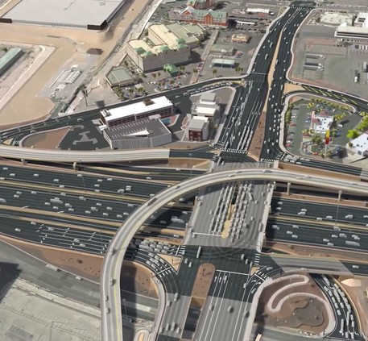
Lit. Review – Incident Modeling
Pal & Sinha (2002)
Small-scale model in Indiana
Dia & Cottman (2006)
VISSIM model in Australia
Sisiopiku et al. (2007)
VISTA model in Chicago
Limitations
Scale
Replicability
Real-world travel behavior
Notes:
UDOT typically prefers VISSIM for analysis, which has been effective in incident studies but is too detailed for practical use along the Wasatch Front. The early-stage incident model developed by Pal & Sinha (2002), while innovative, appears too specific for our project's context and uncertain in scalability. Sisiopiku et al. (2007) employed VISTA for assessing incident impacts and response measures across a large network. However, critiques by Wirtz et al. (2005) highlight VISTA's unrealistic assumption of drivers having perfect travel information. Consequently, we are exploring MATSim, another large-scale DTA model, for our needs.

Slide 7
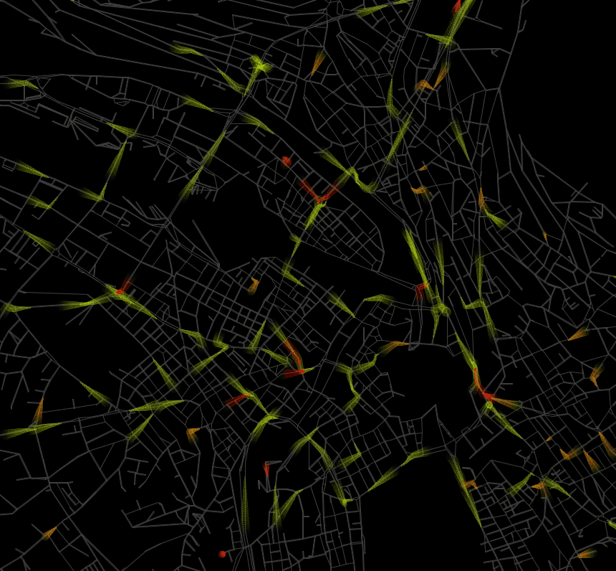
Lit. Review – MATSim
Kaddoura & Nagel (2018): Analyzed traffic incident impacts in Berlin
Li & Ferguson (2020): Studied effects of real-time incident data on travel behavior
Research Gap
Operational Studies: Limited scope; no analysis of hypothetical scenarios
Modeling Studies: Lack IMT impact analysis
Proposed Solution
Evaluate IMT response and performance using MATSim simulations.
Notes:
Why we use MATSim
* Open-source simulation framework
* Large-scale, agent-based modeling
* Adaptable with various modules
* Supports collaborative innovation

Slide 8
 | Microscopic / Performance | Macroscopic / System Optimization
IMT | Skabardonis (1998) Ozbay et al. (2013) Schultz et al. (2023) | MATSim + IMT
Incidents | Pal & Sinha (2002) Dia & Cottman (2006) VISSIM Modeling | Kaddoura & Nagel (2018) Li & Ferguson (2020) MATSim Modeling

Slide 9
Methodology

Slide 10
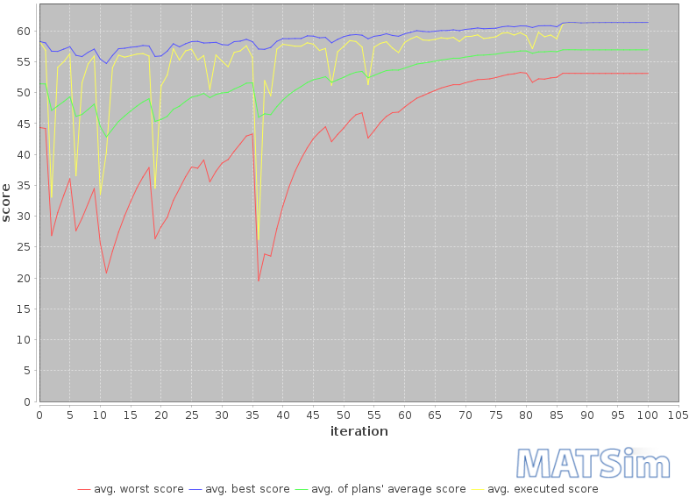
Methodology – MATSim Operations
How MATSim works
Agents
Plans
Scoring
Iterative Learning
Notes:
Agent Behavior: In the simulation, every agent has a daily plan with activities and modes of for travel. They get points for being on time and lose points for being late.
Memory and Replanning Strategies: Agents have a memory that stores plans from their previous 5 iterations of travel. They also have replanning strategies such as route adjustment or departure time alterations, allowing them to adjust plans across iterations.
Simulation Process: The simulation involved processing a large plans file (with over 2 million agents) through 350 iterations without incidents or IMT, followed by an additional 100 iterations with these factors. This method aimed to guide agents towards equilibrium in travel behavior.
Analysis of Simulation Results: The results show how agents adjust their plans and scores over the initial 60 iterations, with scores stabilizing as the simulation progresses. Replanning was disabled after the 85th iteration to ensure stability in the final critical iterations for scenario analysis.

Slide 11
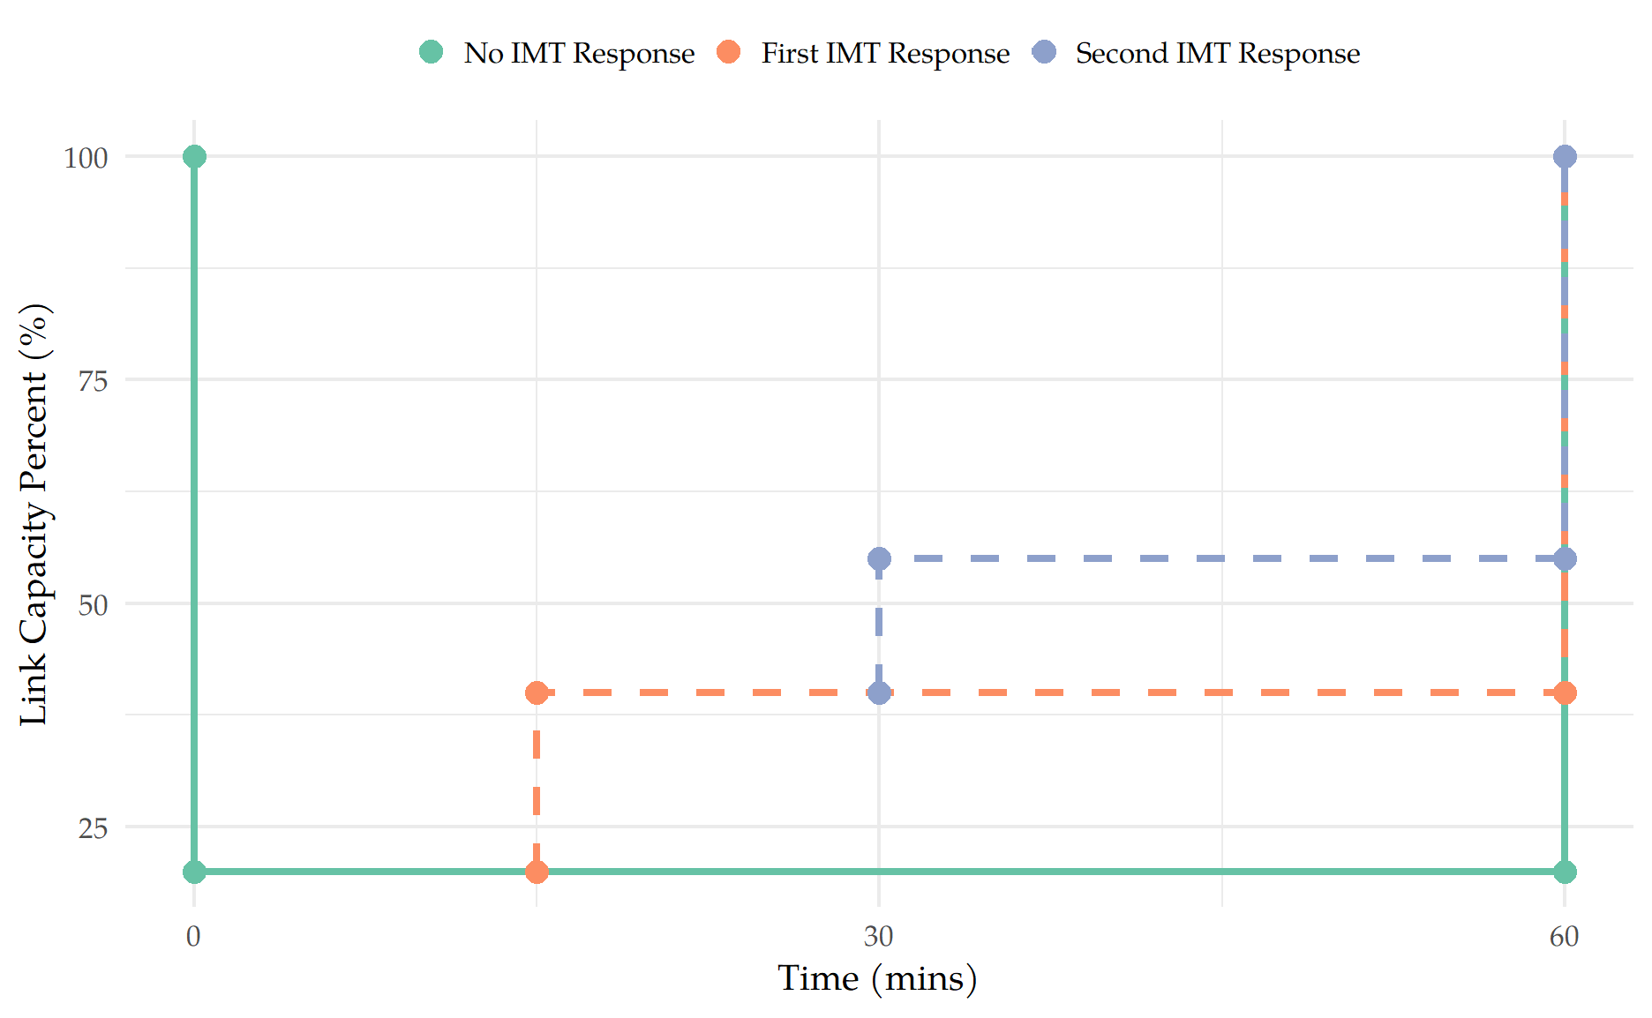
Methodology – Model Design
Incident Requests
Incident Details
# of IMT requested
IMT Dispatch
Least-Cost Path
Restore Capacity
Notes:
Incidents:
Incidents start and end times are based on reported time and RCT
Each incident has a location and capacity reduction, as per the date provided by Schultz et al. (2023).
IMT Dispatch:
Least-Cost Path: calculates the quickest route based on real-time traffic conditions like congestion and link speeds 2. Restore Capacity: they restore 25% of a links lost capacity
Why Capacity:
It’s acknowledged that IMT reduced RCT
The data is from IMT responsive incidents
Determining RCT absent IMT would be challenging
With UDOT counsel we used capacity to illustrate impact
Transition: Move from “this is how the model works” → “these are the inputs used to get the model to work in Utah”

Slide 12
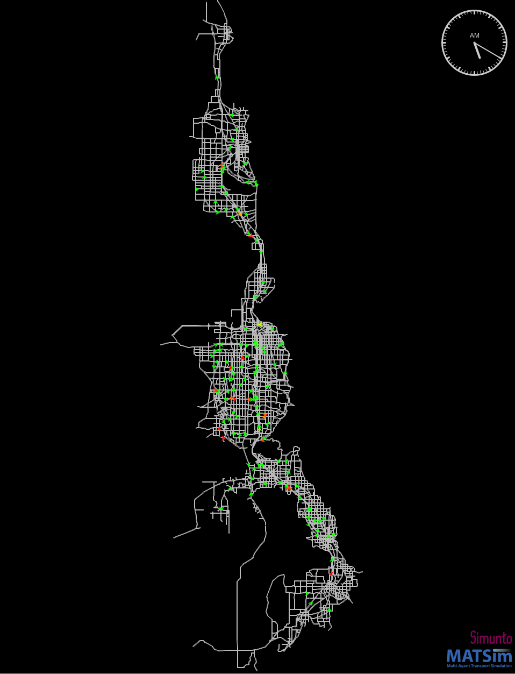
Methodology – Model Implementation
Inputs
Network & Plans
Incident Data
IMT Schedule
Network & Plans
WFRC Model
Day et al. (2023)
Macfarlane & Lant (2023)
Notes:
Inputs: List of the inputs needed to implement the model in Utah
Network & Plans: Just say that the network and plans came from a WFRC model and were additionally calibrated by Chris Day and Mitchell Hadfield

Slide 13
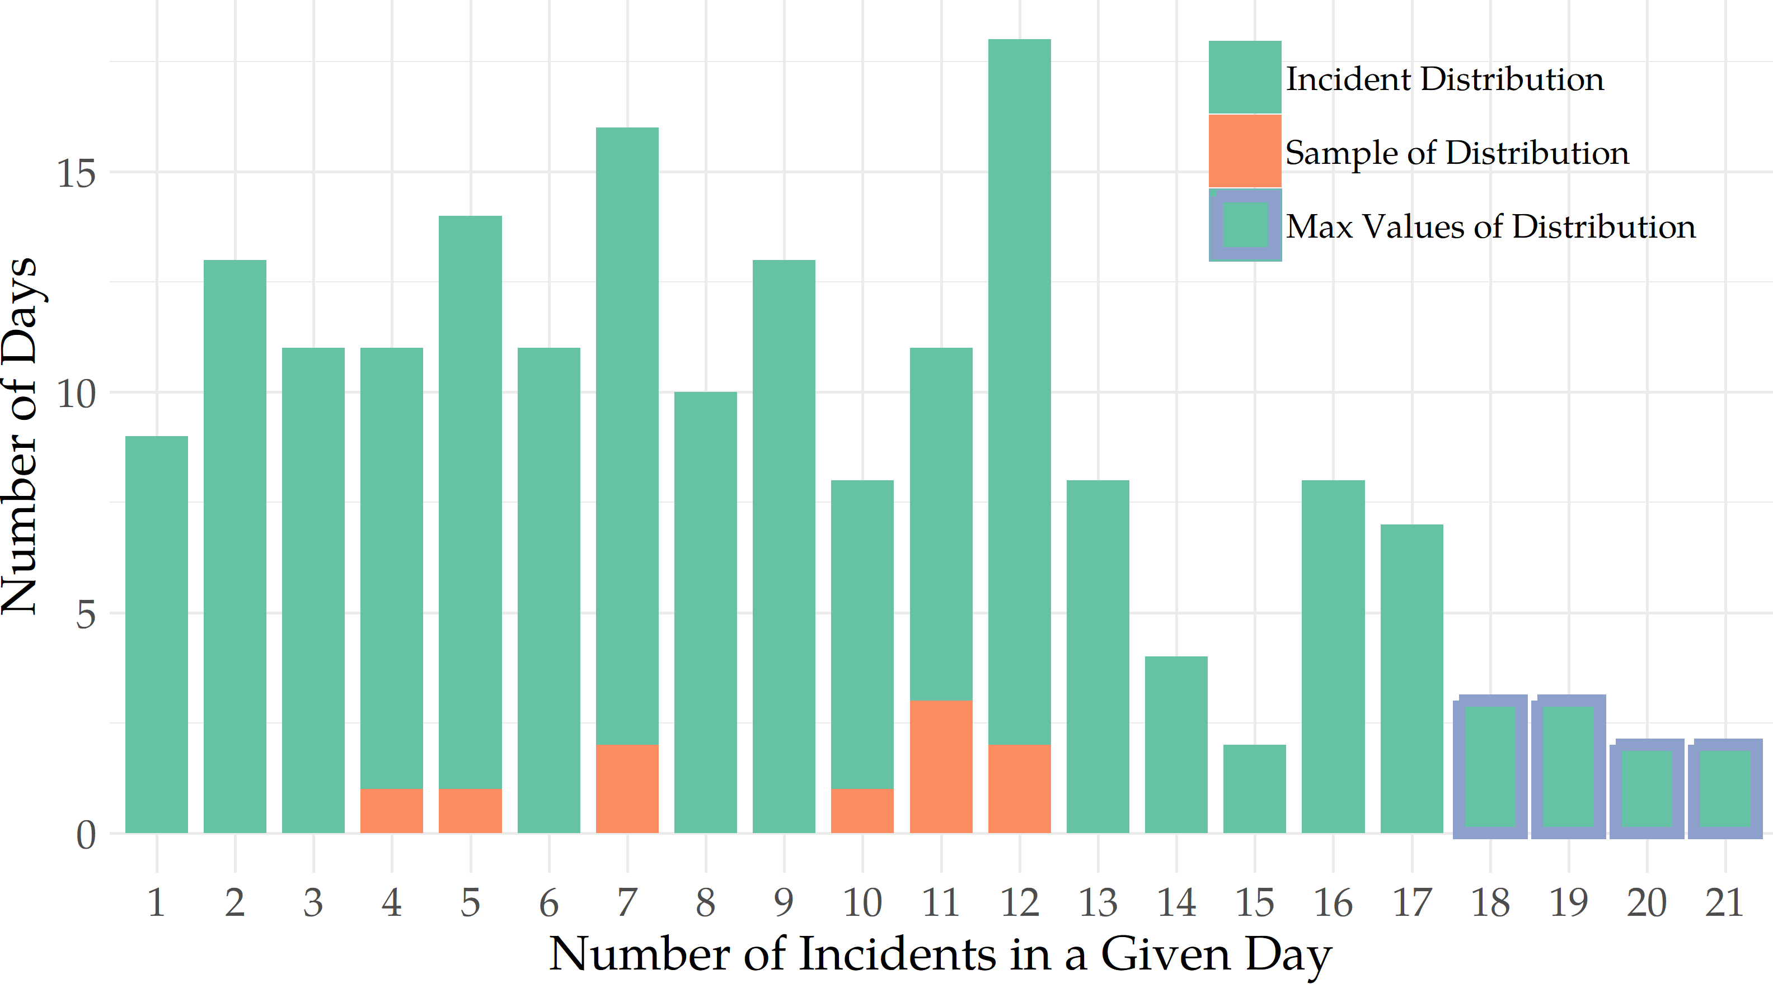
Methodology – Incident Data
Notes:
I think that just having the table here is fine.
Incident Data: Data was provided by Joel (Schultz et al., 2023).
1604 incident used for daily distribution
Sample of Distribution
10 “Number of Incidents in a Given Day” were selected by randomized sampling representing the current incident frequency
10 Highest Values from the distribution were selected to represent a hypothetical increase in incident frequency
Incident Generation: The incidents used in the simulation were from a list of 411 incidents with IMT response, RCT, location, and capacity reduction.
Incidents were selected randomly internally within MATSim (283 incidents in total selected)

Slide 14
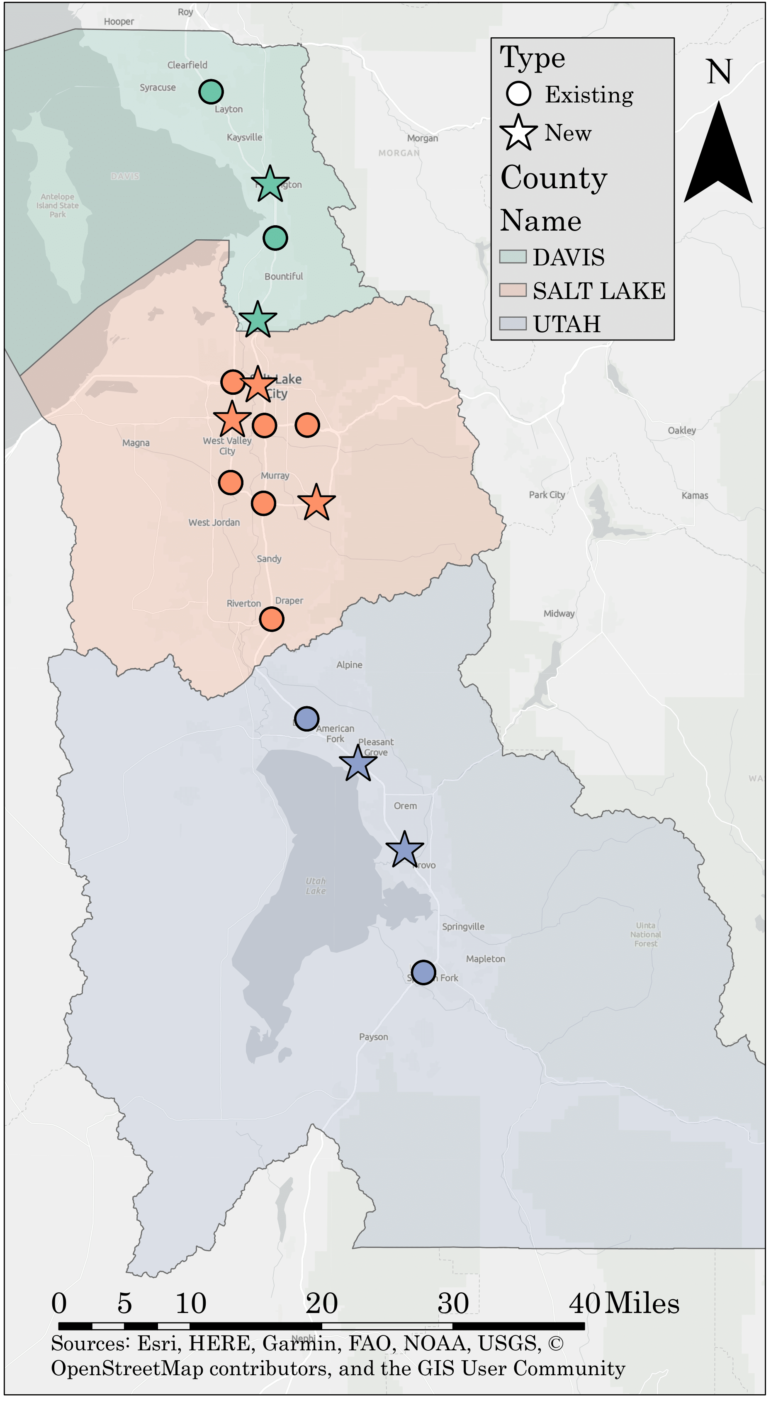
Methodology – IMT Schedule
Notes:
Schedule: IMT Schedule from Tuesday June 6th, 2023, representing their average weekday operations
Map: The original IMT were strategically placed within their coverage zone to achieve a balanced distribution of IMT in each county.
Initial setup doesn’t mirror the real-world scenario where drivers begin their shifts from home, but it serves as a practical model for our simulations.
Number of IMT: 20 IMT in current fleet. 30 IMT in the increased fleet.
Dr. Schultz pointed out that UDOT says that they have 25 IMT operating in Utah
That may be true sometimes (maybe weekends?) but the schedule Ben Goddard sent me had 20

Slide 15
Methodology – Scenario Groups
 | No IMT | 20 IMT – Current Fleet | 30 IMT – Increased Fleet
Current Incident Frequency | 10 Scenarios 4 – 12 incidents per scenario | 10 Scenarios 4 – 12 incidents per scenario | 10 Scenarios 4 – 12 incidents per scenario
Increased Incident Frequency | 10 Scenarios 18 – 21 incidents per scenario | 10 Scenarios 18 – 21 incidents per scenario | 10 Scenarios 18 – 21 incidents per scenario
Note: There is also a Baseline Scenario with no incidents or IMT
Notes:
Scenarios: 61 simulations total 10 in each of the six groups plus the baseline.
Incident Selection: Emphasize the scenarios being compared against each other had the same incident selection.
Transition: Move onto the results by pointing out that scenario groups were compared against each other based on network metrics (VHD) and IMT Performance

Slide 16
Results

Slide 17
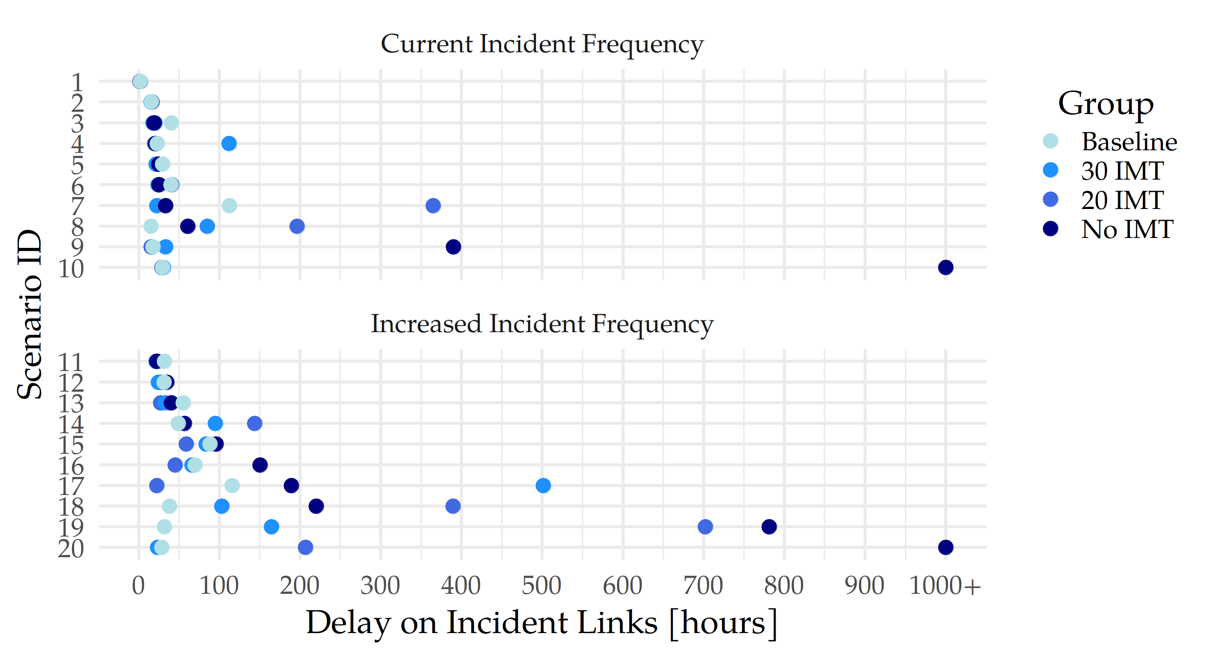
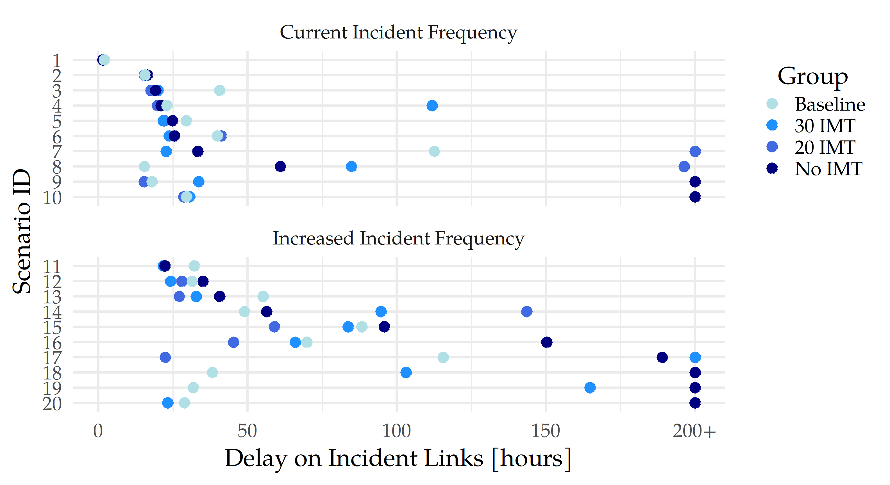
Results – VHD Incident Links
Notes:
There is an animation on this slide to show a more zoomed in version of the same figure.

Slide 18
Results – VHD Motorway
 | No IMT | 20 IMT – Current Fleet | 30 IMT – Increased Fleet
Current Incident Frequency
Increased Incident Frequency
Average VHD Change Compared with 20 IMT
Average VHD Change Compared with No IMT
Average VHD Change Compared with Baseline
Average VHD Change Compared with 20 IMT
Average VHD Change Compared with 20 IMT
-21.9%
58.1%
23.4%
-7.2%
14.6%
-27.5%
-14.1%
45.6%
25.0%
-4.4%
19.5%
-17.9%
Notes:
Calculations:
Motorway: Current Incidents: No IMT → 20 IMT: -21.9% = (24242 – 18924) / 24242 = 21.9% Decrease
No IMT → 30 IMT: -27.5% = (24242 – 17569) / 24242 = 27.5% Decrease
20 IMT → 30 IMT: -7.2% = (18924 – 17569) / 18924 = 7.2% Decrease
Current Incidents: No IMT → 20 IMT: -14.1% = (22321 – 19176) / 22321 = 14.1% Decrease
No IMT → 30 IMT: -17.9% = (22321 – 18327) / 22321 = 17.9% Decrease
20 IMT → 30 IMT: -4.4% = (19176 – 18327) / 19176 = 4.4% Decrease
Discuss the Results:
Groups with IMT had a lower average VHD for both network-wide and motorway-specific delays compared to groups without IMT.
The group with a 30 IMT reported lower VHD than the 20 IMT group for both network and motorway delays.
The expected correlation between increased traffic incidents and delays was not strongly evident. Specifically:
The No IMT group experienced only a 1% increase in network delay with more incidents.
The 20 and 30-minute IMT groups saw a slight decrease in network VHD with more incidents.
Motorway VHD trends varied:
Increased incidents resulted in increased delays for the 20 and 30-minute IMT groups.
The No IMT group showed an unexpected decrease in motorway VHD, suggesting a possible shift of delays from motorways to other network links.
While the 30 IMT group saw a decrease in VHD compared to the 20 IMT group, the difference was not as pronounced with an increase in incidents as expected.
The difference between the two IMT groups' performances was more noticeable at lower frequencies of incidents.

Slide 19
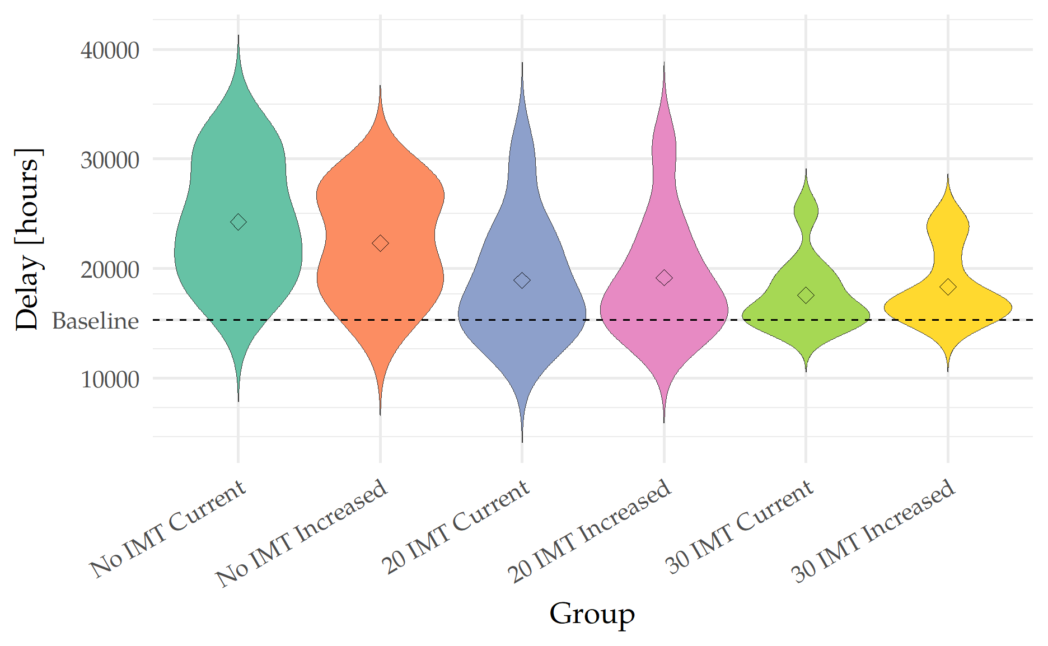
Results – Motorway Delay Distribution
Motorway Delay Distribution
Notes:
A wide span across the plots for both groupings of No IMT, indicating a significant variance in delays across those simulations
A concentration of delays around the Baseline value of 15,000 VHD for both the 20 IMT and 30 IMT scenarios, as shown by the width of the plots at this point
A narrowing of the IMT group plots as they transition to higher delay values, suggesting fewer instances of extreme delays
The upper tails of the 20 IMT plots extend beyond those of the 30 IMT plots, suggesting that the 30 IMT fleet may be more effective at mitigating delays in outlier scenarios compared to the 20 IMT fleet
It may be possible that for the 30 IMT groups agents scores didn’t decrease that much when traveling on motorways, so they kept their “best score” original plan
Conversely if the No IMT or 20 IMT observed lower scores for those vehicles it may have diverted them off the motorway or to different routes
Transition: Go from VHD results to IMT performance

Slide 20
Results – VHD Network
Average Network VHD Shift from Baseline
 | No IMT | 20 IMT – Current Fleet | 30 IMT – Increased Fleet
Current Incident Frequency | 38.3% | 29.7% | 25.7%
Increased Incident Frequency | 39.7% | 28.3% | 25.5%
-6.3%
-3.0%
-9.1%
-8.2%
-2.2%
-10.2%
Notes:
Calculations: Network: Current Incidents: No IMT → 20 IMT: -6.3% = (103159 – 96697) / 103159 = 6.3% Decrease
No IMT → 30 IMT: -9.1% = (103159 – 95678) / 103159 = 9.1% Decrease
20 IMT → 30 IMT: -3.0% = (96697 – 95678) / 96697 = 3.0% Decrease
Current Incidents: No IMT → 20 IMT: -8.2% = (104178 – 95678) / 104178 = 8.2% Decrease
No IMT → 30 IMT: -10.2% = (104178 – 93560) / 104178 = 10.2% Decrease
20 IMT → 30 IMT: -2.2% = (95678 – 93560) / 95678 = 2.2% Decrease
Discuss the Results:
Groups with IMT had a lower average VHD for both network-wide and motorway-specific delays compared to groups without IMT.
The group with a 30 IMT reported lower VHD than the 20 IMT group for both network and motorway delays.
The expected correlation between increased traffic incidents and delays was not strongly evident. Specifically:
The No IMT group experienced only a 1% increase in network delay with more incidents.
The 20 and 30-minute IMT groups saw a slight decrease in network VHD with more incidents.
Motorway VHD trends varied:
Increased incidents resulted in increased delays for the 20 and 30-minute IMT groups.
The No IMT group showed an unexpected decrease in motorway VHD, suggesting a possible shift of delays from motorways to other network links.
While the 30 IMT group saw a decrease in VHD compared to the 20 IMT group, the difference was not as pronounced with an increase in incidents as expected.
The difference between the two IMT groups' performances was more noticeable at lower frequencies of incidents.

Slide 21
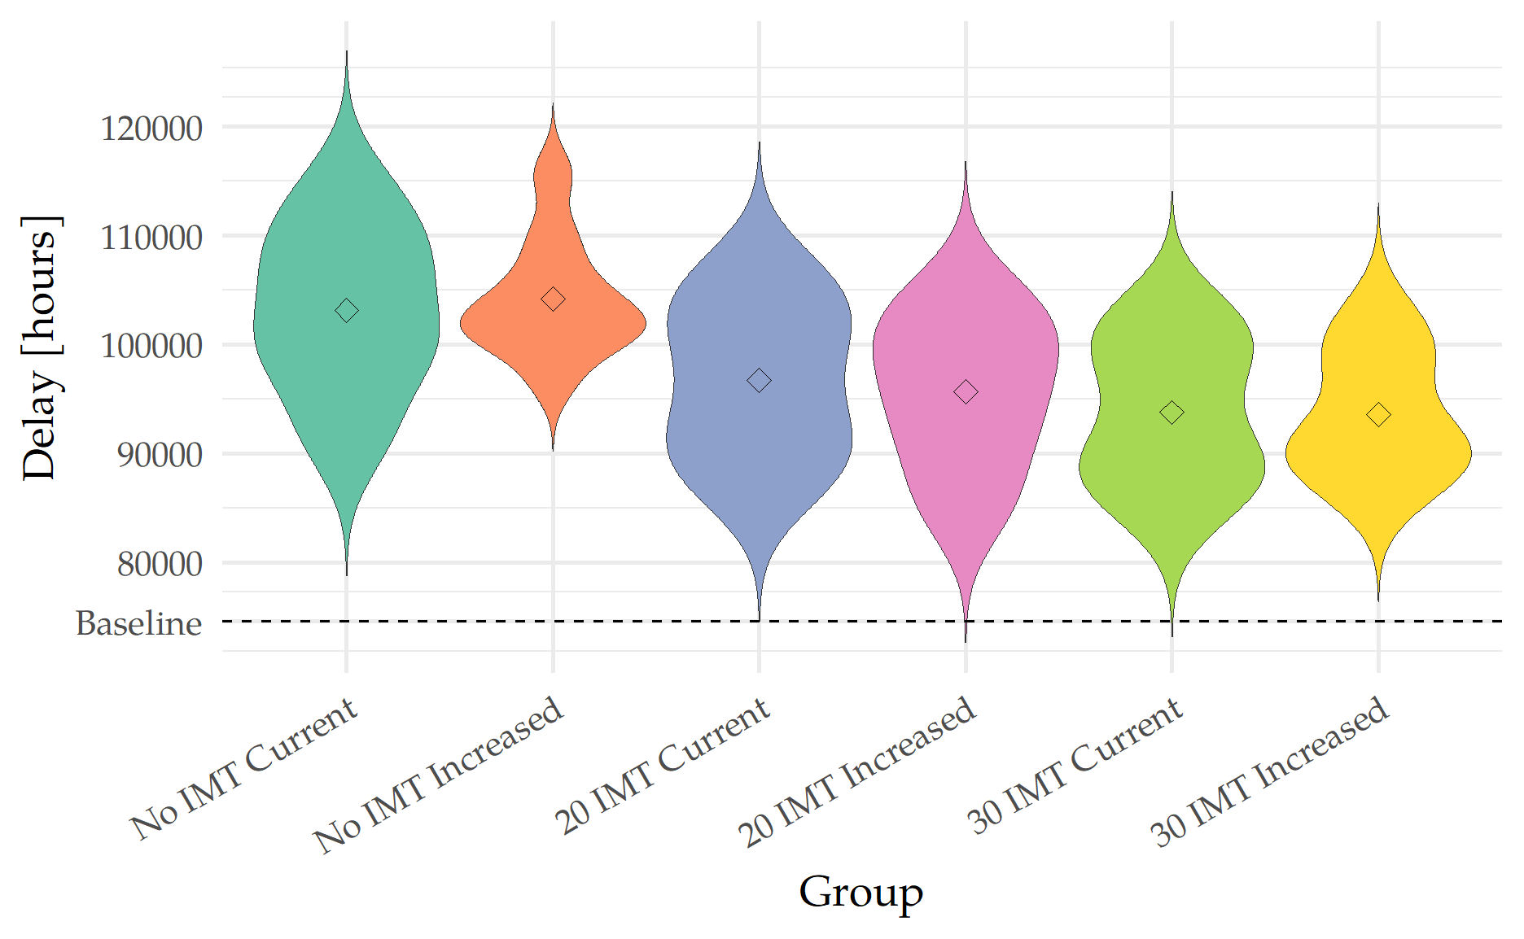
Results – Network Delay Distribution
Network Delay Distribution
Notes:
A wide span across the plots for both groupings of No IMT, indicating a significant variance in delays across those simulations
A concentration of delays around the Baseline value of 15,000 VHD for both the 20 IMT and 30 IMT scenarios, as shown by the width of the plots at this point
A narrowing of the IMT group plots as they transition to higher delay values, suggesting fewer instances of extreme delays
The upper tails of the 20 IMT plots extend beyond those of the 30 IMT plots, suggesting that the 30 IMT fleet may be more effective at mitigating delays in outlier scenarios compared to the 20 IMT fleet
It may be possible that for the 30 IMT groups agents scores didn’t decrease that much when traveling on motorways, so they kept their “best score” original plan
Conversely if the No IMT or 20 IMT observed lower scores for those vehicles it may have diverted them off the motorway or to different routes
Transition: Go from VHD results to IMT performance

Slide 22
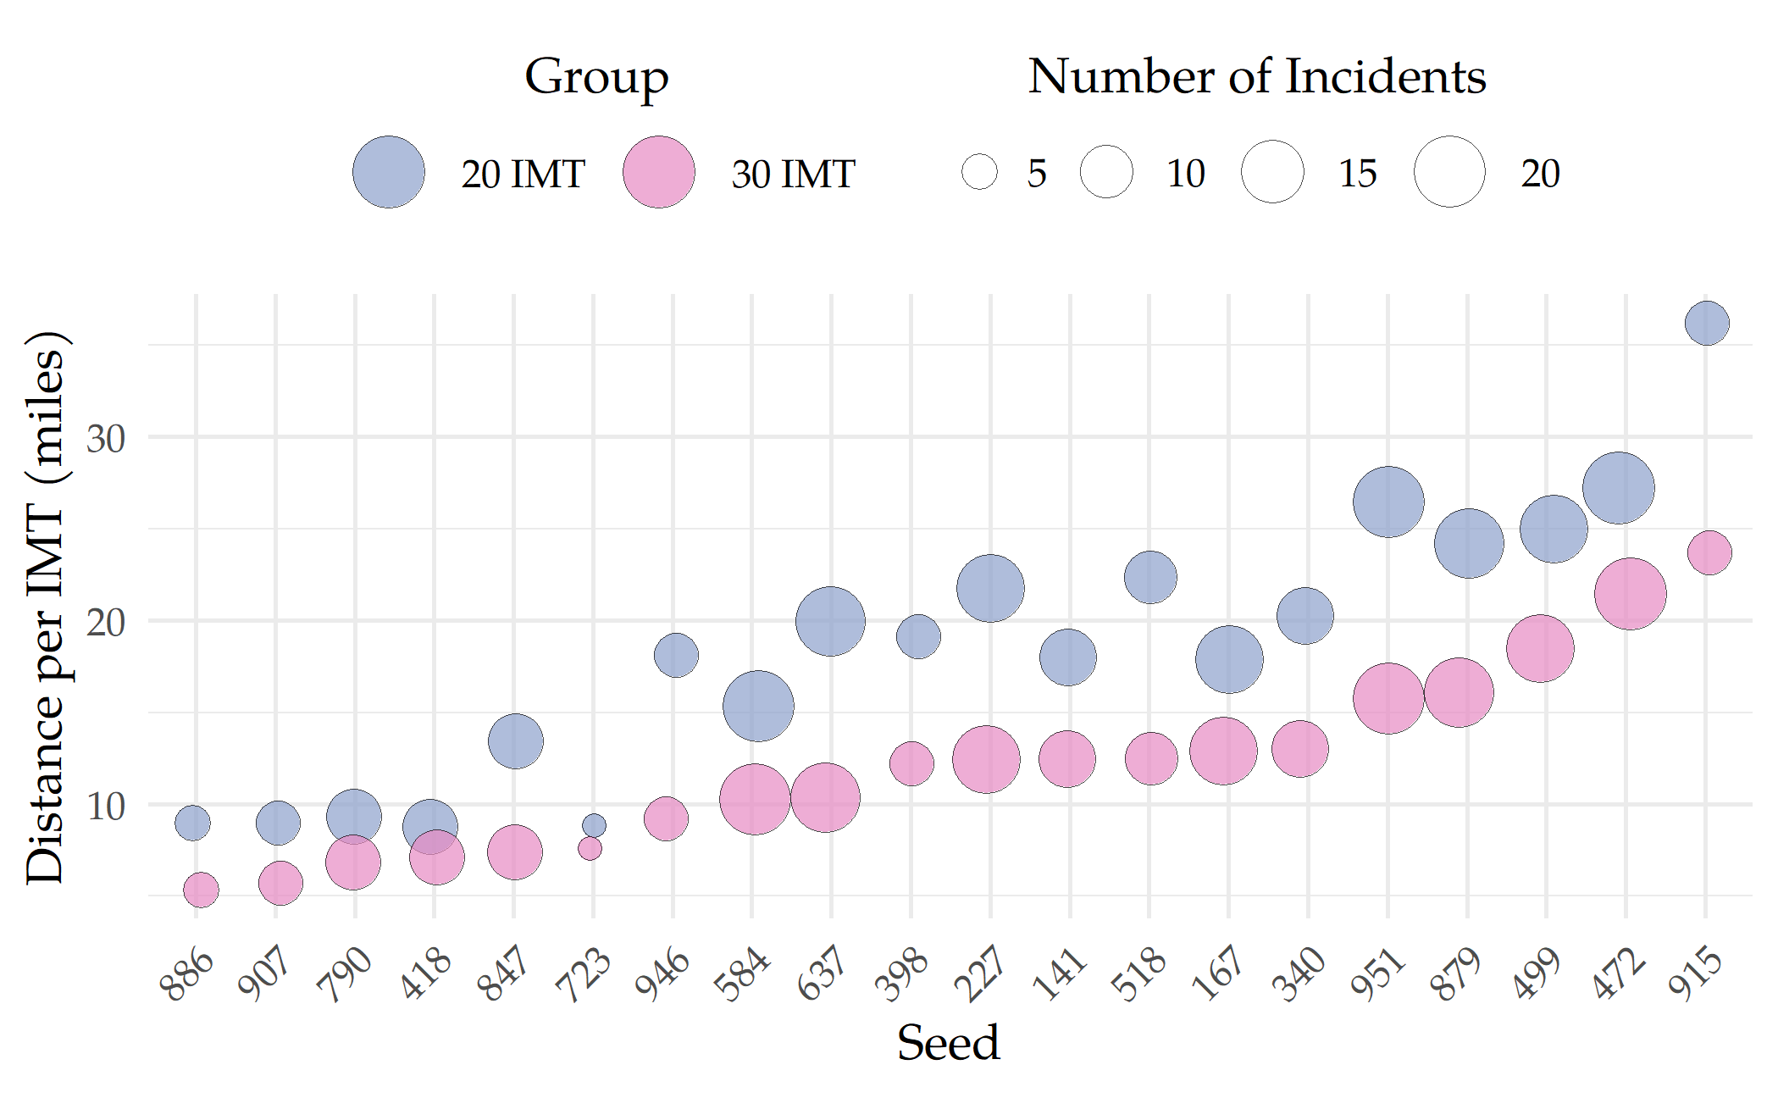
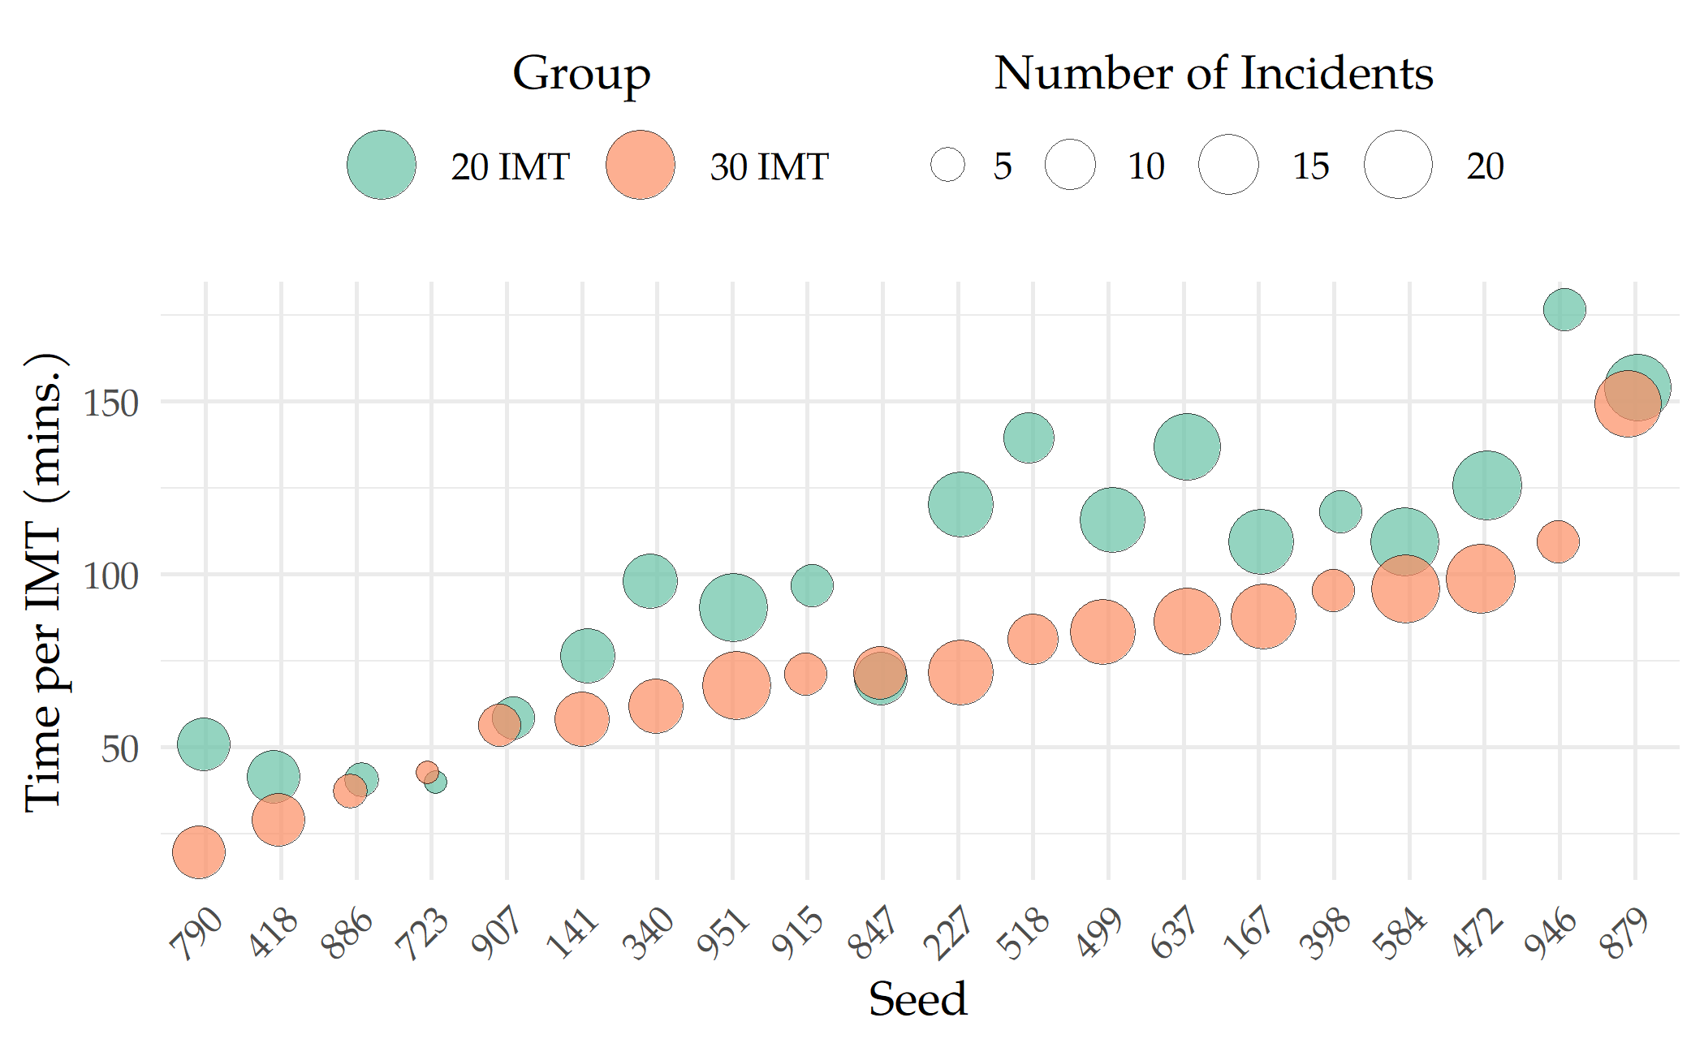
Results – IMT Travel
Average Distance Traveled
Average Time Traveled
Total Travel Distance (Miles)
20 IMT | 5254
30 IMT | 3864
Difference | 1390
Total Travel Time (Hours)
20 IMT | 463
30 IMT | 394
Difference | 69
Notes:
1390 Miles / 20 MPG * $4.00 per gallon = $278 over 20 days

Slide 23
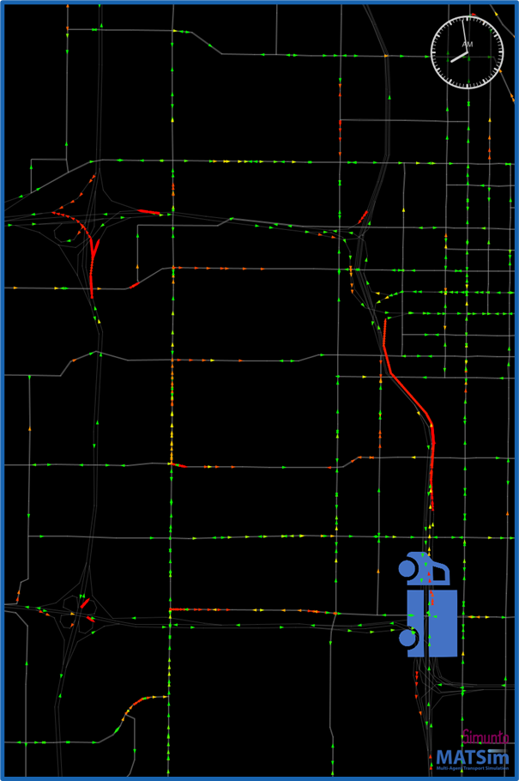
Results – IMT Arrival
Average IMT Arrival Times (mins)
Group | All IMT | 1st | 2nd | 3rd
20 IMT | 15.0 | 11.1 | 21.1 | 28.9
30 IMT | 11.0 | 8.9 | 13.2 | 21.2
Difference | 4.0 | 2.2 | 7.9 | 7.7
# of Incidents | 280 | 280 | 116 | 23
The 20 IMT fleet's average arrival time is 15 minutes, consistent with the times reported by Schultz et al. (2023)
Hadfield et al. (2021) determined that every additional minute of IMT delay resulted in a $925 increase in EUC
4 min. improved RT → $3,700 per incident

Slide 24
Conclusions

Slide 25
Conclusions – Implications
IMT impact on VHD
Level | Group | VHD | Change (%)
Network | No IMT | 103669 | -
Network | 20 IMT | 96188 | 7.2
Network | 30 IMT | 93665 | 9.6
Motorway | No IMT | 23282 | -
Motorway | 20 IMT | 19050 | 18.2
Motorway | 30 IMT | 17948 | 22.9
Tool for Macro Analysis + System Optimization
IMT Expansion Analysis
Reduce VHD
Improve RT ~ 4 mins
Increased Incident Analysis
Model Explores ‘What-If’ Scenarios
Future: Optimize locations, operational hours

Slide 26
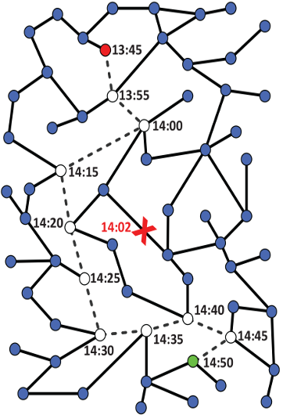
Conclusions – Limitations
Within-Day Replanning
Improves response to unexpected events (Dobler et al., 2012)
Iterative models anticipate incidents early (Dobler et al., 2012)
Incidents simulated similarly to construction closures
Simulated agents' decisions may not reflect real drivers

Slide 27

Conclusions – Next Steps
Within-Day Replanning
Evaluate additional factors
IMT starting locations
Dispatch Zones
Explore Clearance Time
Other roadside services

Slide 28
Thank You

